Slide 1

Zoom Information and Tutorial

Slide 2
Law IT Staff
Brandon Tubinis
Law Lab Manager
John Christensen
Systems Administrator
Tedros Teklzghi
Help Desk Manager

Slide 3

What is Zoom
Zoom is a web based audio and video conferencing platform used for trainings, meetings, events, etc.
Who can use Zoom
Zoom has been distributed to all Law School staff and fulltime faculty, allowing hosting privileges
Anyone can be invited into Zoom as an attendee

Slide 4
Licensing and the Law School Enterprise
There are two licenses of Zoom: Basic and Pro
  When invited into the Law School Zoom you are granted a Basic license by default
  The Law School pays for a limited number of Pro license to be distributed amongst the Enterprise members on an as needs basis
Basic
  1 to 1 meetings - unlimited time
  100 attendees w/ 40 minute limit
  Local recordings
Pro
  1 to 1 meetings unlimited time
  300 attendees unlimited time
  Local and cloud recordings

Slide 5
Software and Hardware Requirements
Zoom software options
  Clients are available for Windows, Mac, Android and iOS
  Zoom can be launch from a browser with a minimal plugin install
  A plugin is available for Outlook to make scheduling as simple as creating a calendar event
Zoom hardware requirements
  Display, if you want to see displayed content
  Speakers, if you want to hear what is being said
  Microphone, if you want to be heard
  Camera, if you want to be seen
  Mixed media opportunities
    One meeting can be joined any combination of desktop computers, laptop computers, smartphones, tablets or telephones

Slide 6
What are the Main Features
Video and audio conferencing
Desktop sharing
Whiteboard
Collaboration
Remote desktop control
Option to record session

Slide 7
What Would I Use Zoom
Online teaching, or hybrid classroom
Virtual Office Hours
Large, public events
Collaborating with remote participants
Training (synchronous and asynchronously)
Remote desktop sharing
Simple phone conferencing

Slide 8
Specific Examples
Faculty
  Hold office hours online (from anywhere)
  Have a guest speaker join your class by live video
  Hold class even when I’m out of town or snowed-in
  Host a seminar or workshop for off-site participants
  Meet with collaborators from around the world
  Pre-record presentation for distribution or posting
Staff
  Set up a meeting in Exchange with colleagues at other UB campuses or universities
  Hold long distance interviews
  Host live, continuing education training
  Remote desktop support

Slide 9
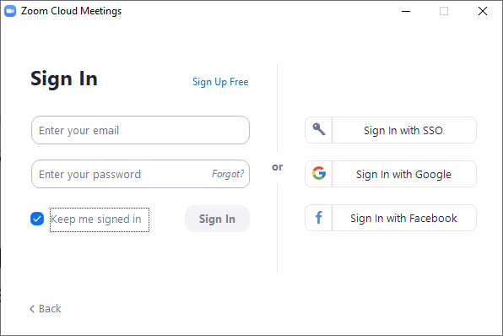
Usage Tutorial
Launch the Zoom Client. If you haven’t logged into the service before, do so now with your UBIT email address and credentials. You can check the “Keep me logged in” box so that you won’t need to login every time.

Slide 10
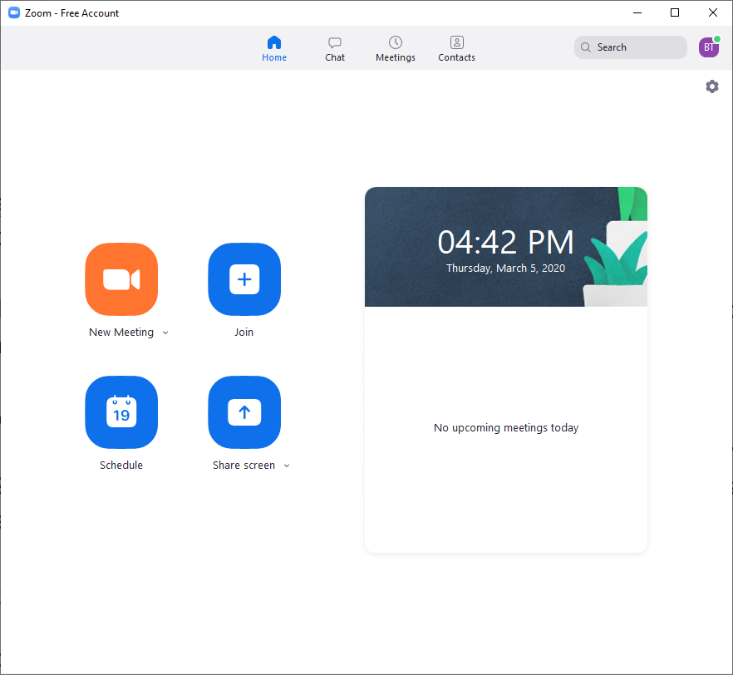
Usage Tutorial
With the client logged into now you will see the main Zoom software page that offers all your functions. The features that will be discussed can all be found on the “Home” tab on the top.

Slide 11
Usage Tutorial
The yellow icon will start an on-the-fly meeting.

Slide 12
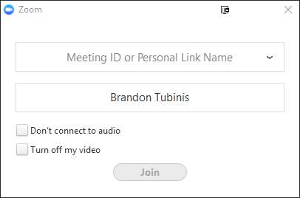
Usage Tutorial
The blue “Join” icon will launch a login window allowing you to manually input a meeting ID that you’ve received, a link with an invitation or to drop down and select from a list of offered meetings.

Slide 13
Usage Tutorial
The blue “Schedule” icon will launch the Zoom scheduling wizard which will allow you to create a meeting with various options and to create a calendar event or a link to send out invitations.

Slide 14
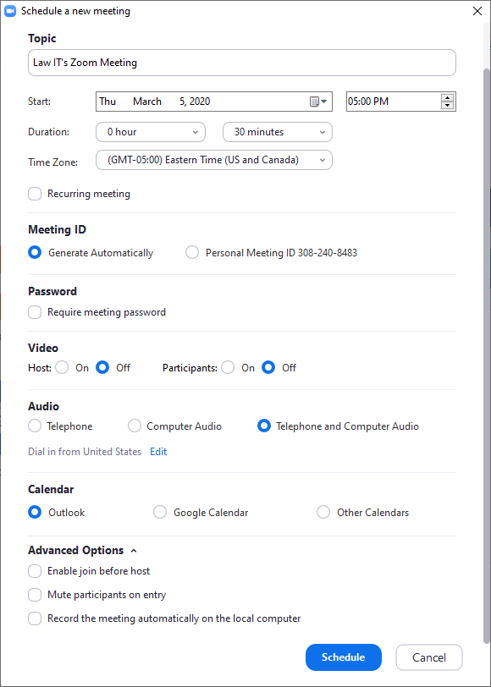
Usage Tutorial
In the Scheduling wizard you can
  Name your meeting
  Set it’s date. Including time and duration. You can also find the “Recurring meeting” box here if this meeting will repeat.
  Enable or disable video
  Choose audio options
  Create an event in your preferred calendar
  Enable a lobby or set automatic audio/recording options

Slide 15
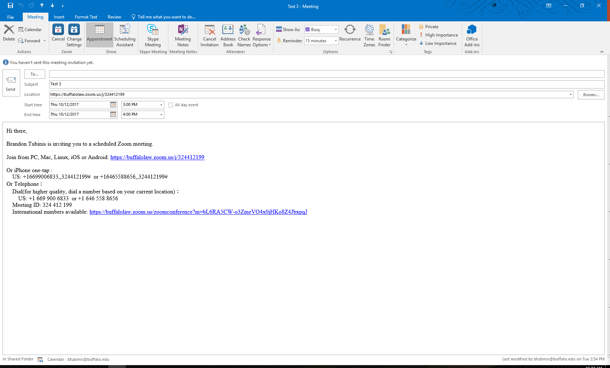
Usage Tutorial
Your invitation message will look like this, this is a calendar event that can be shared out to your attendees via email. Your attendees simply need to click the URL invite to join. They can also call in with the telephone number but used alone

Slide 16
Usage Tutorial
The “Share Screen” icon will ask you to join a meeting similar to the “Join” icon but will automatically join with your computer being viewable by the other attendees.

Slide 17
Usage Tutorial
Now we will move onto the “Meetings” tab at the top.

Slide 18
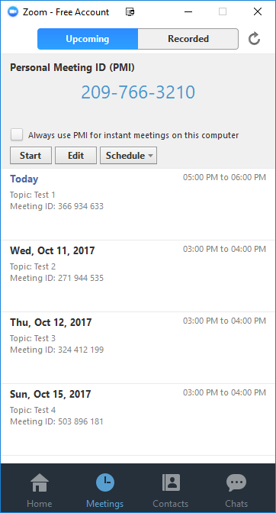
Usage Tutorial
In the Meetings Window the topmost option will always be a “Personal Meeting” that when selected will initiate a quick meeting right away if you select “Start” or can schedule a meeting that utilizes your personal Zoom ID account number.

Slide 19
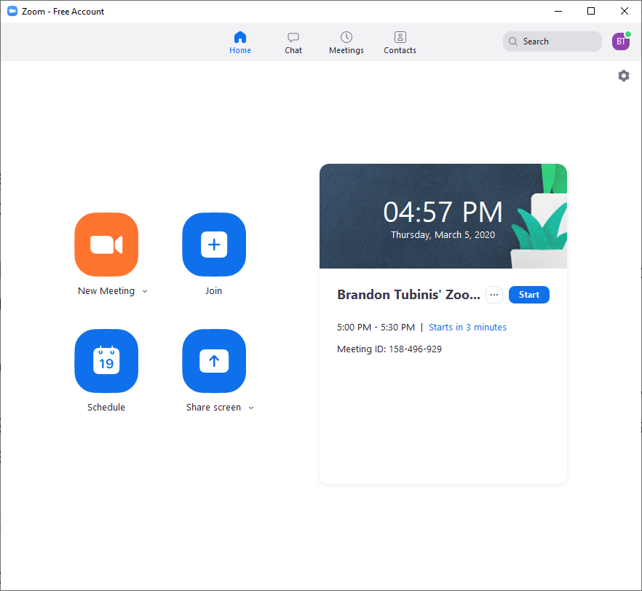
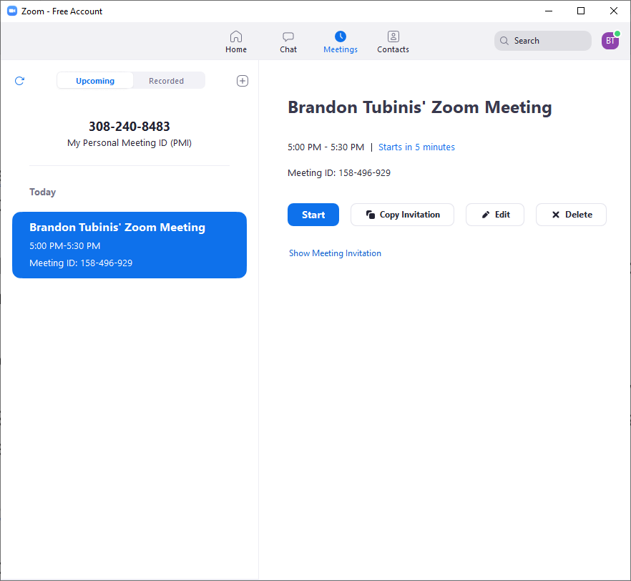
Usage Tutorial
When wanting to join a meeting that you have scheduled yourself simply select the meetings from those listed and select “Start”

Slide 20
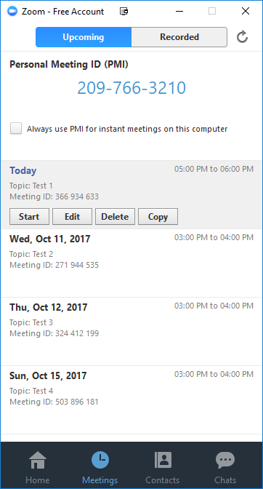
Usage Tutorial
You can copy the invitation message and link to your meeting so that you can email it to your attendees easily with the “Copy invitation” button.
You can managed the date and join options with the “Edit” button.
Or delete the meeting with the “Delete” button.

Slide 21
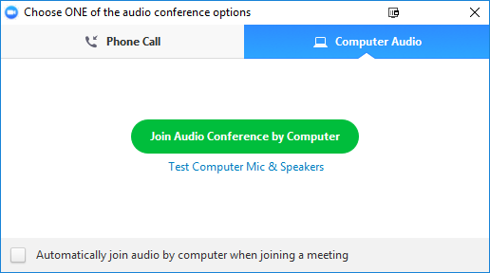
Usage Tutorial
Once you have started the meeting you will be greeted with this message. Click the large green “Join Audio Conference by Computer” to enable the microphone options on you computer.

Slide 22
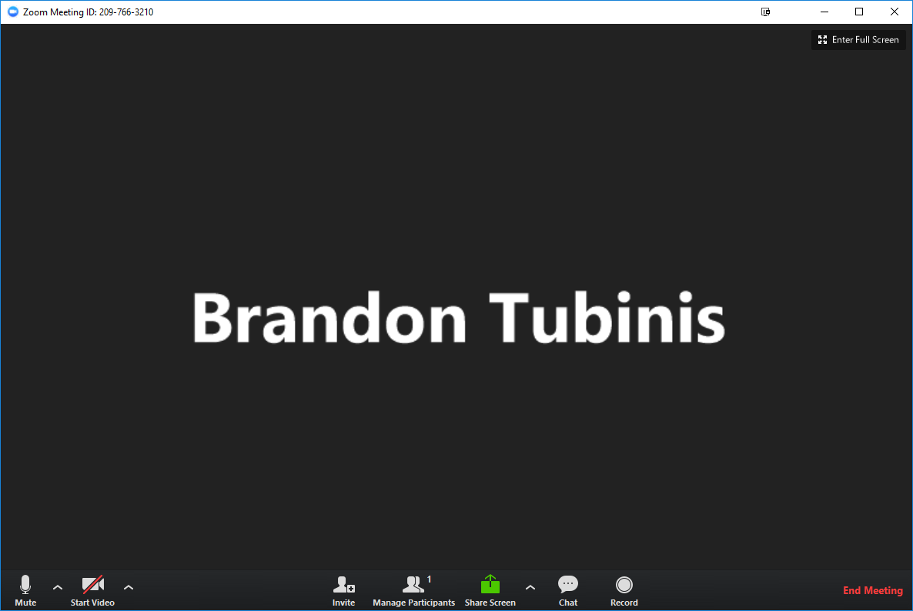
Usage Tutorial
In the meeting you may enter full screen or maximized view.

Slide 23
Usage Tutorial
When you have multiple participants you can select Gallery or Speaker view which will show either all the participants equally or will show the current speaker in an expanded view which switches as new people speak.

Slide 24
Usage Tutorial
Once in the meeting you may enable or disable your audio or video option by clicking the corresponding mic or cam icons. Note the red X through the video, this denotes a disabled device.

Slide 25
Usage Tutorial
The carrots next to the audio and video icons can be clicked to expand options if you have multiple recording options or if you are currently on the wrong device.

Slide 26
Usage Tutorial
The “Invite” icon can be used to invite people into a meeting on-the-fly.

Slide 27
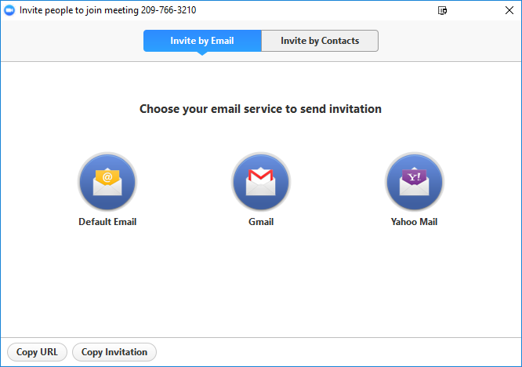
Usage Tutorial
In the Invite window you can select “Default Email” to automatically generate an email with the invitation prewritten. You can also select “Copy URL” or “Copy Invitation” to have that information in your clipboard where you can paste to any service you’d like.

Slide 28
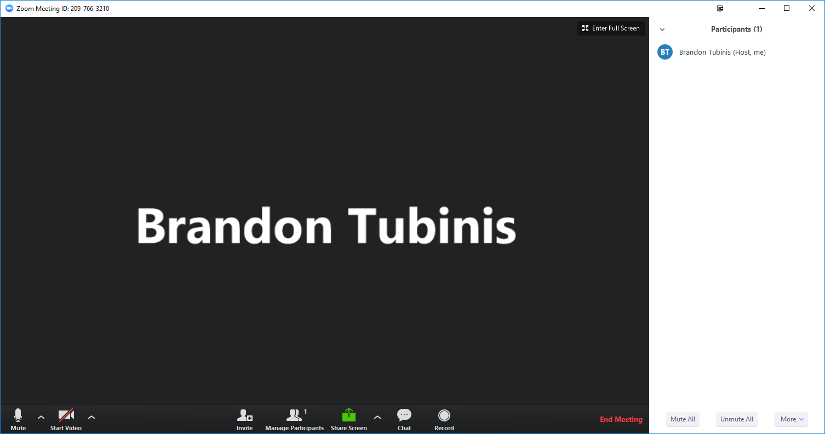
Usage Tutorial
The “Manage Participants” icon is used to mute, unmute, enable or disable video, etc.

Slide 29
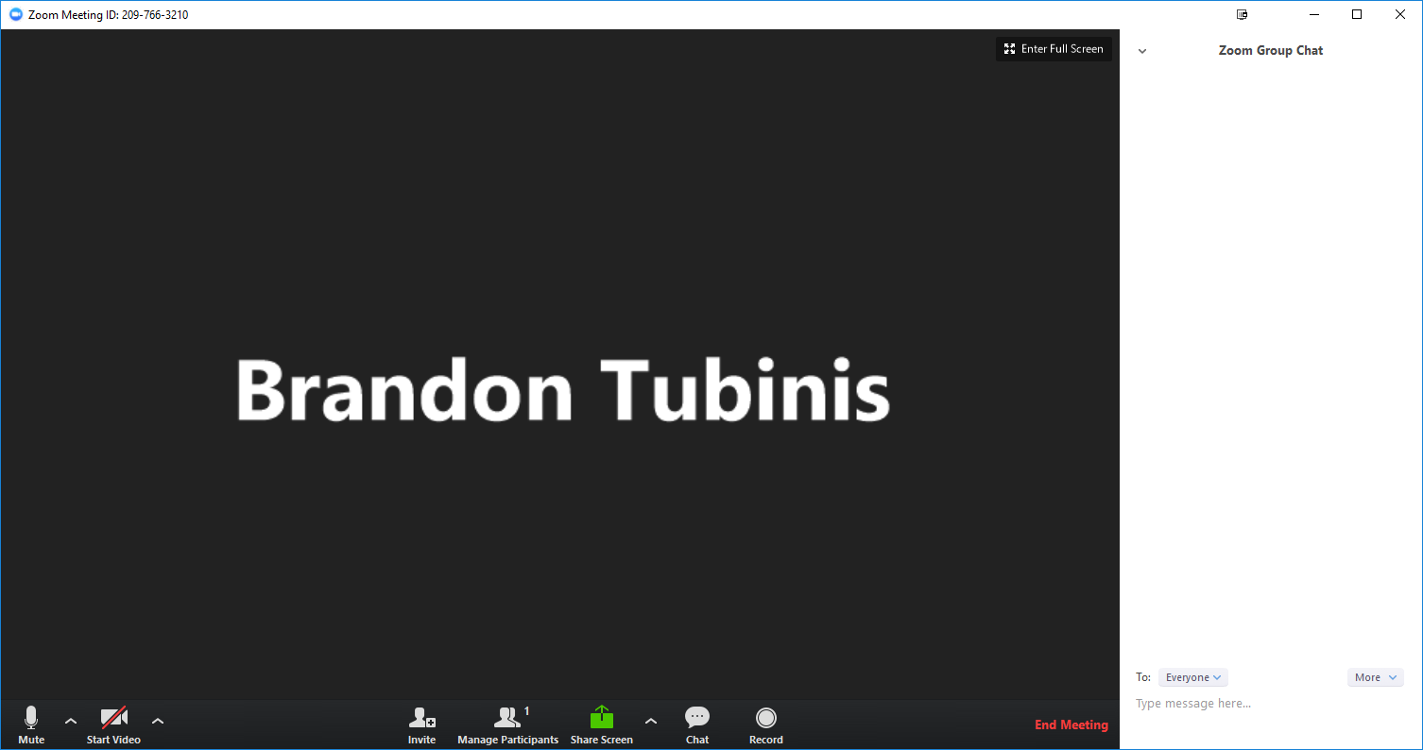
Usage Tutorial
The “Chat” icon can be used by yourself or your attendees to enter text to the group or to whisper individuals. The host can also disallow whispering.

Slide 30
Usage Tutorial
The “Record” icon is used to record the meeting in its entirety including audio, video and screen captures. Once the meeting is closed the meeting is saved to a specified folder location.
Pro license holders will have the option to save the recording to a Cloud storage space, but our license of Zoom does not afford much space so it is advised to always save locally.

Slide 31
Usage Tutorial
The “Screen Share” icon is used to allow your attendees to see something that is on your screen. Whether that is the entirety of your computer or a specific program can be specified here.

Slide 32
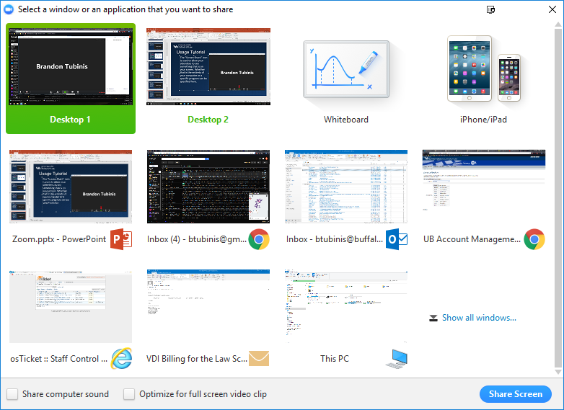
Usage Tutorial
The Screen Share window allows you to share your entire desktop, or specific programs like PowerPoint. Simply double click the program or select the program so it is highlighted and select “Share Screen”.

Slide 33
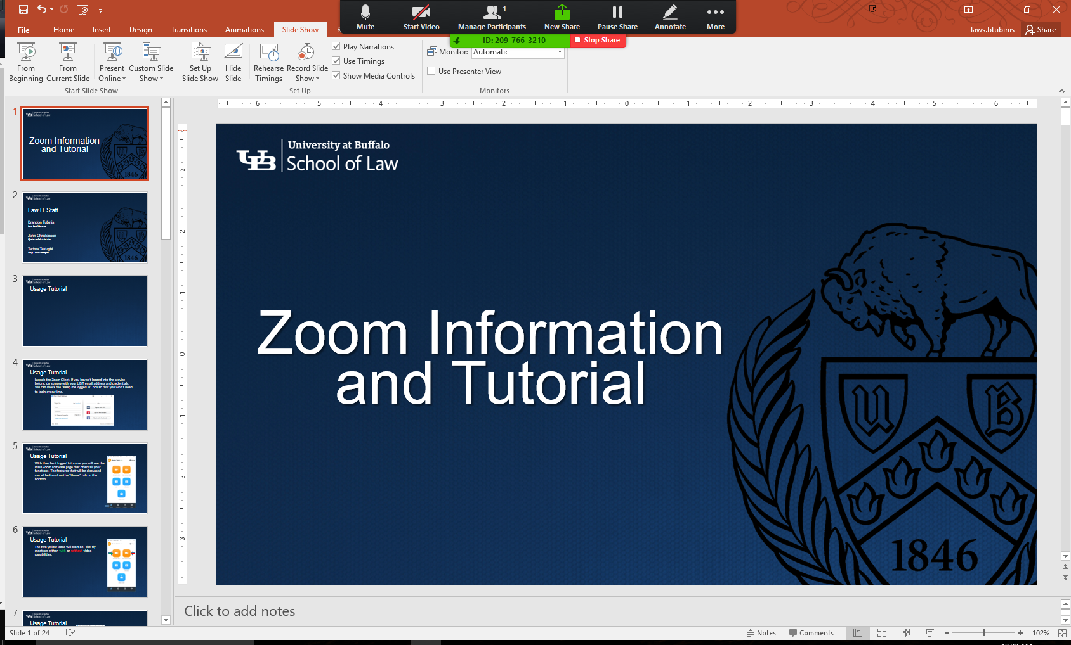
Usage Tutorial
Once screen sharing the screen share options get attached to the top of the screen which will auto-collapse after 3 seconds. You can pause the sharing or make annotations with markers.

Slide 34
Usage Tutorial
Once done with screen sharing click the “Stop Share” button to cancel the screen share session.

Slide 35
Usage Tutorial
Once the meeting is over select “End Meeting” to end the meeting and confirm.

Slide 36
Zoom Tutorials and Training
Zoom support website: https://support.zoom.us/hc/en-us
In-depth training recording: https://livetraining.zoom.us/rec/play/6Zx8f-j7qDw3GNeQswSDAPJ-W9S4J6qshiYfqfcNyk20WyIHNFChb7pHZuClKrDVR76R1BxgtMF4txaS?continueMode=true

